Slide 1
Modelling of Polycrystalline deformations using finite element approach
Objective
The objective of this project was to “ model the uniaxial tensile test of any material ”
To simulate the actual process on our system
Remove the use of long experimentation ( low strain rates )
Compare and contrast many samples together with exact same conditions ( difficult in real experiment )

Slide 2
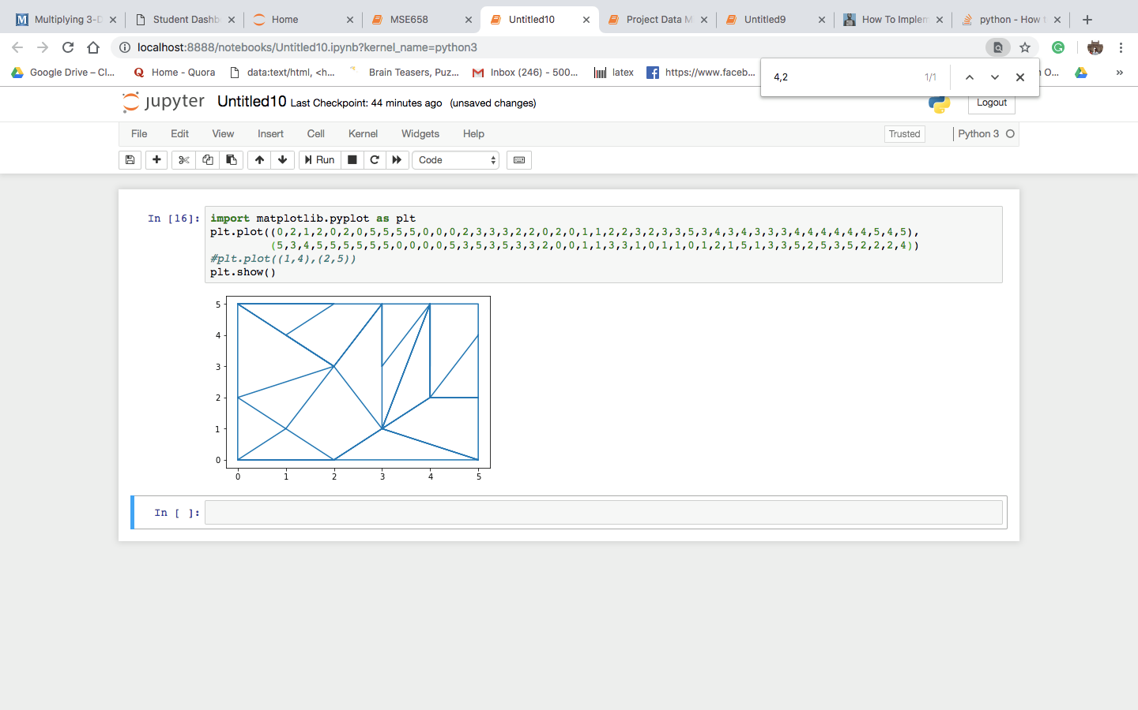
Overview
A polycrystalline grain is to be deformed with the external conditions similar to that of an uniaxial tensile test
Stress and strain behaviour is governed by the motion of mobile dislocations through the defined slip systems
FCC crystal lattice is assumed,
2D model is being simulated , thus having same slip plane.

Slide 3
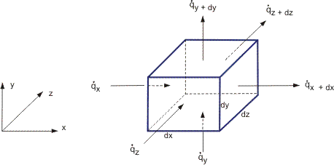
Governing equation
The governing equation is derived from , mobile dislocation balance expression . Assuming a Control volume, and finding the dislocation influx,outflux & source term ; Expressed with an unsteady term (time derivative term)

Slide 4
Results
The mobile dislocation density formulation using CFD approach
Computer simulations os the problem
Deformation model of single grain
Compatible model to accommodate neighbouring grains
Final animations

Slide 5
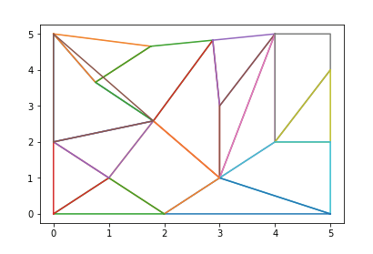
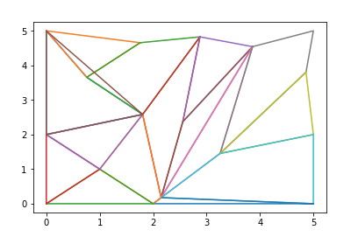
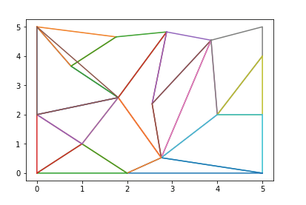
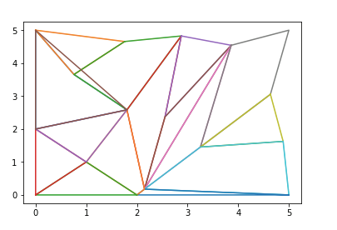
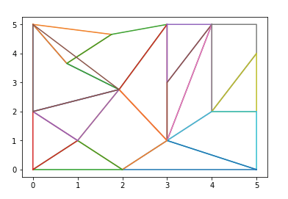
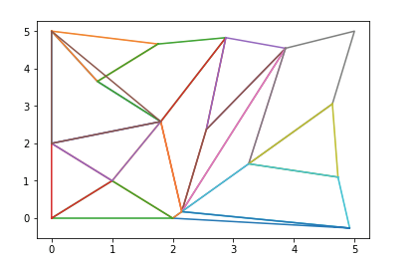
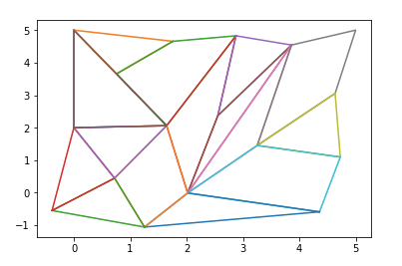
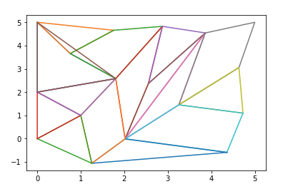
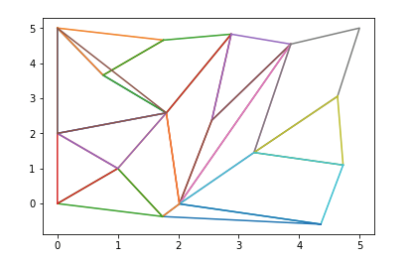
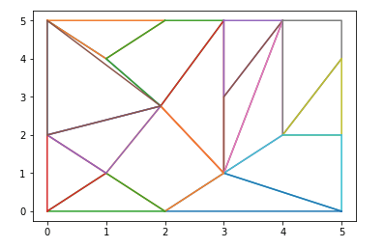
Animations

